Slide 1
Project Management
Lecture Slide #1

Slide 2
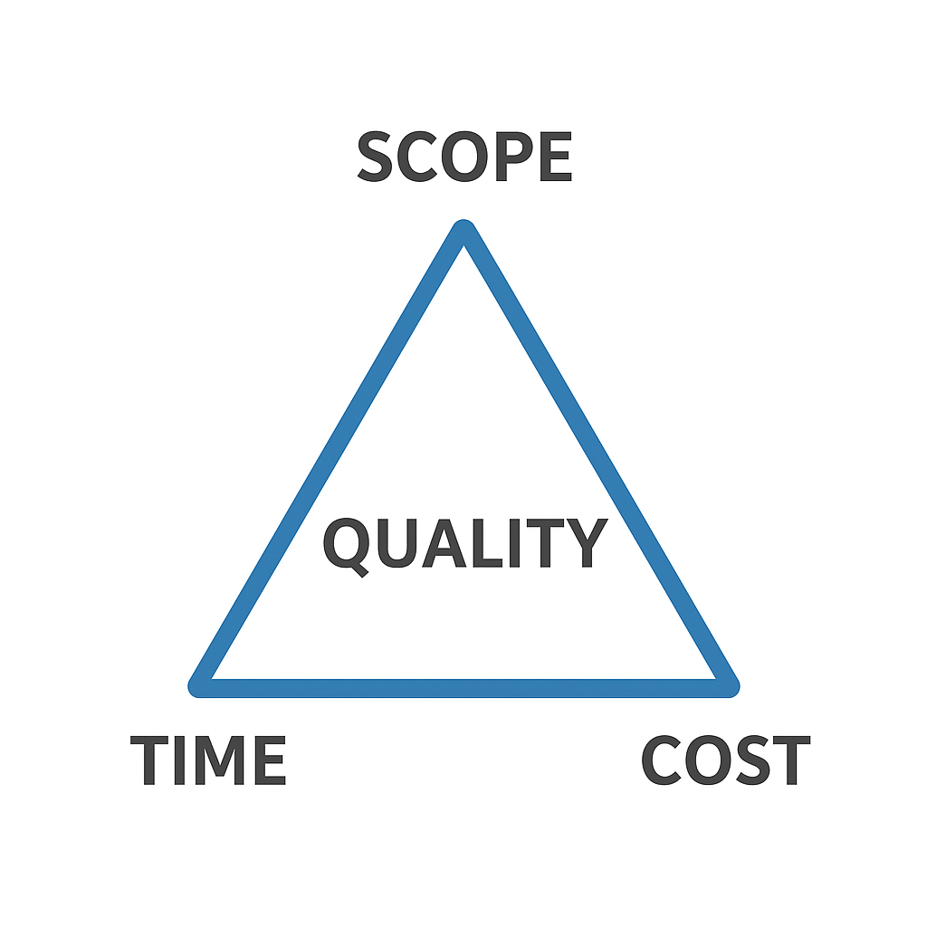
What is a Project?
Definition: A temporary endeavor with a clear start & end.
Creates a unique product, service, or result.
Managed under scope, time, cost, and quality constraints.

Slide 3
What is a Project?
Projects have a start and an end
Start may be unclear as ideas evolve
End must be clearly defined
Projects deliver unique outcomes
Tangible (e.g., software)
Intangible (e.g., guidelines)

Slide 4
Project vs. Operations
Projects: Temporary, unique, goal-oriented
Operations: Ongoing, repetitive, sustain existing systems
Example:
Project → Develop a new mobile app
Operation → Maintain university IT servers

Slide 5
What is an IT Project?
Involves technology-based solutions.
Examples:
Software development
Cloud migration
Cybersecurity implementation
ERP/CRM deployment
Typically complex, high-risk, and dynamic.

Slide 6
Project Agreement
Document written for a client that defines:
the scope, duration, cost and deliverables for the project.
the exact items, quantities, delivery dates, delivery location.
Can be a contract, a statement of work, or a business plan.
Client: Individual or organization that specifies the requirements and accepts the project deliverables.
Deliverables (= Work Products that will be delivered to the client):
Documents
Demonstrations of function
Demonstration of nonfunctional requirements
Demonstrations of subsystems

Slide 7
When is a project successful?
The traditional view on project success consists of three parts and is also called the iron triangle or triple-constraint:
The project scope is well-defined
The project is executed on time.
The project is executed within budget.
The project produces an outcome of high quality.

Slide 8
What is Project Management?
The application of knowledge, skills, tools, and techniques to meet project requirements.
Deliver unique outcomes on time, within budget, and with desired quality.
Goal: Balance the iron triangle (Scope–Time–Cost) while ensuring quality and stakeholder satisfaction.

Slide 9
Project Management Activities (continued on next slide)
Initiation
Problem statement
definition
Initial top-level
Initial milestones
design
planning
Team formation
Communication
infrastructure setup
Project kickoff

Slide 10
Project kickoff
Steady state
Status monitoring
Risk management
Project replanning
Project agreement
Termination
Installation
Client acceptance test
Postmortem

Slide 11
Project Management Methodologies
Different frameworks, standards, and methodologies with respect to project management have been established. For example:
PMBOK
Prince2
Agile Project Management
Waterfall
Scrum
Kanban
Six Sigma

Slide 12
PMBOK Overview
Full Name: Project Management Body of Knowledge (PMBOK)
Publisher: Project Management Institute (PMI)
Recognized by: ANSI, IEEE, Popular in USA
Defines 47 processes → tools & techniques to achieve project results
Organized into 5 Process Groups:
Initiating,
Planning,
Executing,
Monitoring & Controlling,
Closing

Slide 13
PMBOK Overview
Additionally, PMBOK also organizes these 47 processes into 10 Knowledge Areas:
Project Integration Management
Project Scope management
Project Schedule Management
Project Cost Management
Project Quality Management
Project Resource Management
Project Communications Management
Project Risk Management
Project Procurement Management
Project Stakeholder Management

Slide 14
Prince2 Overview
Full Name: PRojects IN Controlled Environments
Origin: UK Government (Information Systems Projects)
Popular in: UK, EU, Australia
41 activities grouped into 7 processes:
Starting Up a Project
Initiating a Project
Directing a Project
Controlling a Project
Managing Product Delivery
Managing a Stage Boundary
Closing a Project

Slide 15
Agile Project Management Overview
Origin: Agile Software Development
Waterfall approach → less structured, flexible
Agile Manifesto → 4 Core Values
Values focus on:
People & communication
Documentation
Collaboration with clients
Responding to change
Welcome changes
Simplicity and sustainable development
Continuous reflection & adjustment
Early & continuous delivery

Slide 16
Kanban Project Management
A visual project management method
Work items are represented by cards (tasks).
A typical Kanban board has columns
To Do → In Progress → Review/Testing → Done
Advantages of Kanban
Transparency → Everyone can see what’s being worked on.
Flexibility → Easy to reprioritize tasks.
Efficiency
Continuous delivery → Work is released as soon as it’s ready, not in big batches.

Slide 17
Example of Kanban Board (Software Team)
To Do | In Progress | Review | Done
Task 1: Fix login bug | Task 4: Develop checkout API | Task 5: Test payment gateway | Task 2: Update homepage
Task 3: Add user profile page | Task 6: Write documentation |  | Task 7: Deploy v1.2

Slide 18
Scrum Method
An Agile framework that delivers value in short, time-boxed iterations (Sprints) of 2–4 weeks.
Key Roles:
Product Owner – Represents the customer/business. Manages backlog & priorities
Scrum Master – A facilitator/coach for the team. Ensures Scrum principles are followed.
Development Team – Cross-functional members (developers, testers, designers, etc.). Self-organizing, delivers work

Slide 19
Scrum Events (Ceremonies)
Scrum has a fixed cycle of events:
Sprint Planning – Decide what to work on in the upcoming sprint.
Daily Scrum (Stand-up Meeting) – 15-minute daily check-in to track progress.
Each member answers:
What did I do yesterday?
What will I do today?
Any blockers?
Sprint Review – Present completed work to stakeholders for feedback.
Sprint Retrospective – Team reflects on what went well, what to improve, and adjusts for the next sprint.

Slide 20
Role of an IT Project Manager
Responsibilities:
Plan, execute & deliver IT projects
Balance scope, time, cost
Lead cross-functional teams
Mitigate IT-specific risks
Ensure compliance & quality

Slide 21
Common Challenges in IT Projects
Scope creep (changing requirements)
Rapid tech changes
Budget & timeline overruns
Stakeholder conflicts
Integration with legacy systems

Slide 22
Laws of Project Management !!!
Projects progress quickly until they are 90% complete. Then they remain at 90% complete forever.
When things are going well, something will go wrong. When things just can’t get worse, they will. When things appear to be going better, you have overlooked something.
If project content is allowed to change freely, the rate of change will exceed the rate of progress.

Slide 23
Assignment – Class 1: Introduction to Project Management
Instructions: Choose one real-life project (personal, academic, or professional). Examples:
Developing a mobile app
Organizing a cultural program
Building a website
Planning a family trip
Tasks:
Identify the Goal
Clearly state the main objective of the project.
Identify Stakeholders
List at least 3–5 stakeholders (individuals/groups involved or affected).
Mention their role or interest in the project.
Identify Constraints (Iron Triangle)
Scope: What will be delivered?
Time: Estimated duration/deadlines.
Cost: Budget/resources required.
(Also mention Quality as the “fourth constraint”).
Reflection
Write briefly (5–6 lines) about why managing these elements is important for project success.

